Slide 1
Entity-Relationship Model

Slide 2
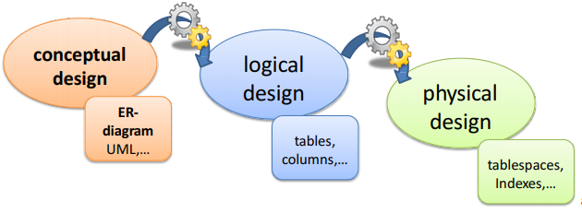
Steps in Database Design
While modeling the data, three design phases have to be completed
The result of a phase serves as input to the next phase

Slide 3
Example: Database Design for Banking Institution
Requirements Specification
Determine the requirements of clients (Database to store information about customers, accounts, loans, branches, transactions, …)
Conceptual Design
Express client requirements in terms of E/R model.
Confirm with clients that requirements are correct.
Specify required data operations
Logical Design
Convert E/R model to relational, object-based, XML- based,…
Physical Design
Specify file organizations, build indexes

Slide 4
ER Modeling
Traditional approach to Conceptual Modeling
Entity-Relationship Models (ER-Models)
Also known as Entity-Relationship Diagrams (ERD)
Introduced in 1976 by Peter Chen
Graphical representation
Top-Down-Approach for modeling
Entities and Attributes
Relationships
Constraints

Slide 5
ER Model Basics
Entity
Real-world object distinguishable from other objects. For example, each student in a university is an entity
Entity set
Collection of similar entities. Similar to a class in object-oriented languages.
Attribute
Property of (the entities of) an entity set.
Attributes are simple values, e.g. integers or character strings, not structs, sets, etc.
Example: name of an employee, color of a car, balance of an account, location of a house,…
Relationship
Association among two or more entities.
For example, we can define a relationship works in that associate's employee Ram with department Computer Science
Relationships have name, set of entities that participate in them, degree i.e., the number of entities that participate and cardinality ratio

Slide 6
Example
A university consists of a number of departments. Each department offers several courses. A number of modules make up each course. Students enrol in a particular course and take modules towards the completion of that course. Each module is taught by a lecturer from the appropriate department, and each lecturer tutors a group of students
A university consists of a number of departments. Each department offers several courses. A number of modules make up each course. Students enrol in a particular course and take modules towards the completion of that course. Each module is taught by a lecturer from the appropriate department, and each lecturer tutors a group of students
Entity
A university consists of a number of departments. Each department offers several courses. A number of modules make up each course. Students enrol in a particular course and take modules towards the completion of that course. Each module is taught by a lecturer from the appropriate department, and each lecturer tutors a group of students
Relationship

Slide 7
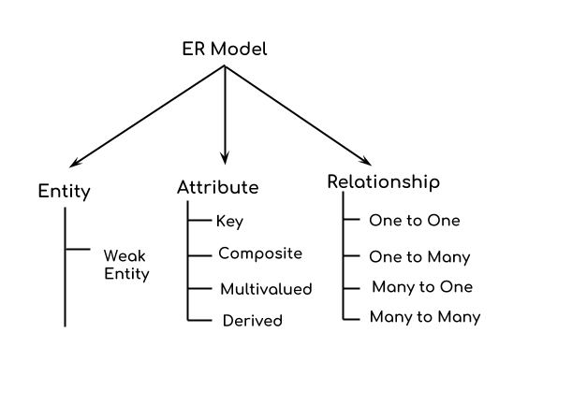
Components of a ER Diagram
Image Source: https://beginnersbook.com/2015/04/e-r-model-in-dbms/

Slide 8
Entity Relationship Diagram Symbols

Slide 9
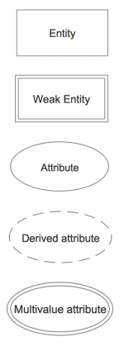
Entity Relationship Diagram Symbols
An entity is represented by a rectangle which contains the entity’s name.
An entity that cannot be uniquely identified by its attributes alone. The existence of a weak entity is dependent upon another entity called the owner entity.
Each attribute is represented by an oval containing atributte’s name.
An attribute whose value is calculated (derived) from other attributes.
An attribute that can have many values (there are many distinct values entered for it in the same column of the table).

Slide 10
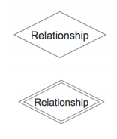
Entity Relationship Diagram Symbols
An entity is represented by a rectangle which contains the entity’s name.
An entity that cannot be uniquely identified by its attributes alone. The existence of a weak entity is dependent upon another entity called the owner entity.

Slide 11
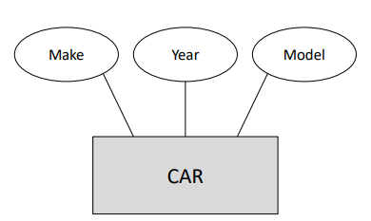
Entity Sets
Set of entities that have the same attributes
All cars have a year, make, and model.

Slide 12
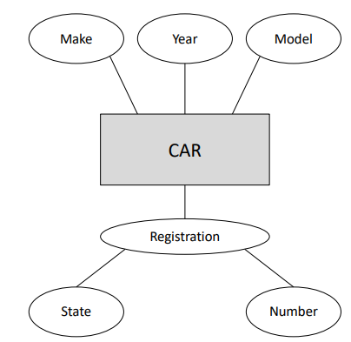
Composite Attributes
Can be subdivided into smaller subparts
All cars have a year, make, model, and registration.

Slide 13
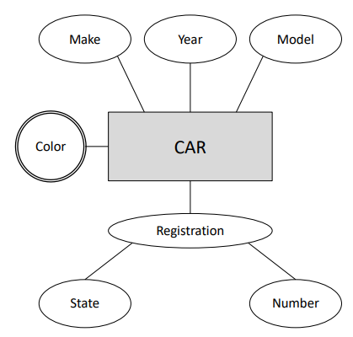
Multivalued Attributes
Can take a number of values.
All cars have a year, make, model, registration, and some number of colors.

Slide 14
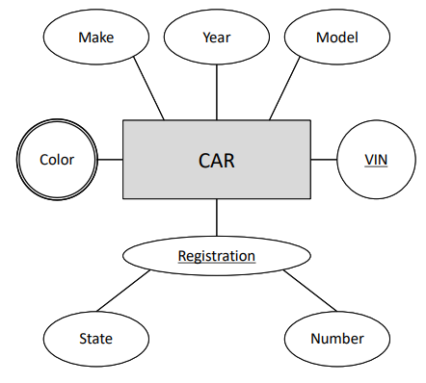
Key Attributes
The value uniquely identifies each entity
All cars have a year, make, model, registration (unique), vehicle number (vin; unique), some number of colors

Slide 15
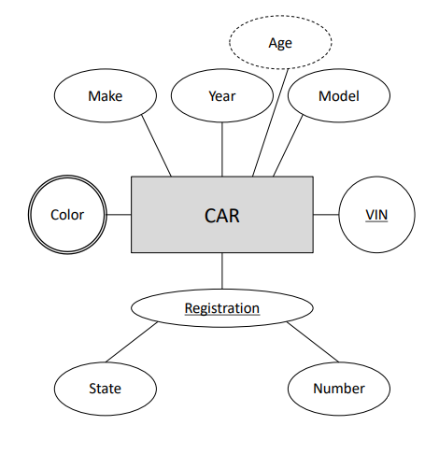
Derived Attributes
The value can be computed
All cars have a year, age, make, model, registration (unique), vehicle number (vin; unique), some number of colors.

Slide 16
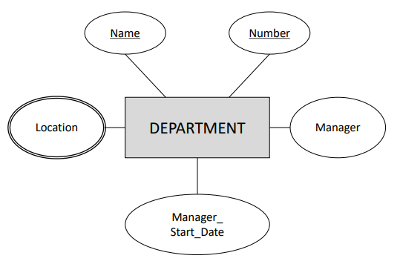
Exercise
Draw an ERD for the following description:
Each department has a unique name, a unique number, and a particular employee who manages the department. We keep track of the start date when that employee began managing the department. A department may have several locations.

Slide 17
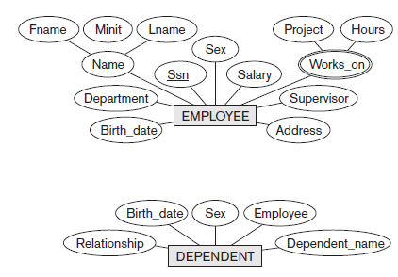
Weak Entity
Entity types that do not have key attributes of their own
Identified by their relationship to specific entities from another entity type
Example
Dependent is meaningless in COMPANY DB independently of Employee
Identified by relationship to Employee
Dependent_name distinguishes one dependent from other dependents for the same employee: partial key

Slide 18
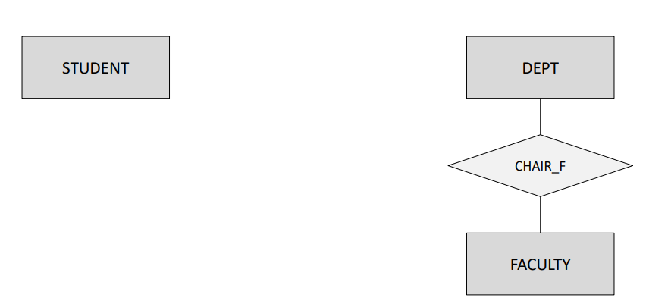
Relationships
Associates one or more sets of entities
One = recursive (role is important)
Example
All departments have a faculty member who serves as the chair. A faculty member can only chair one department.

Slide 19
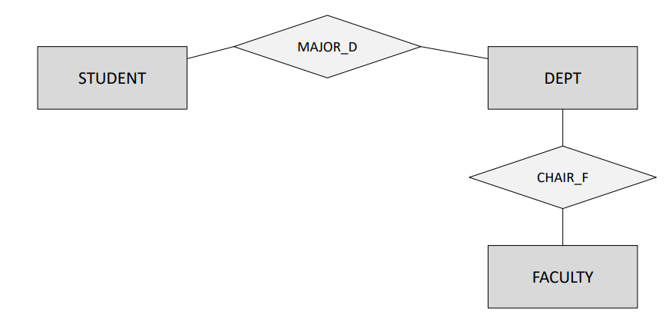
Relationships
Associates one or more sets of entities
One = recursive (role is important)
Example
All students must have a department in which they major.

Slide 20
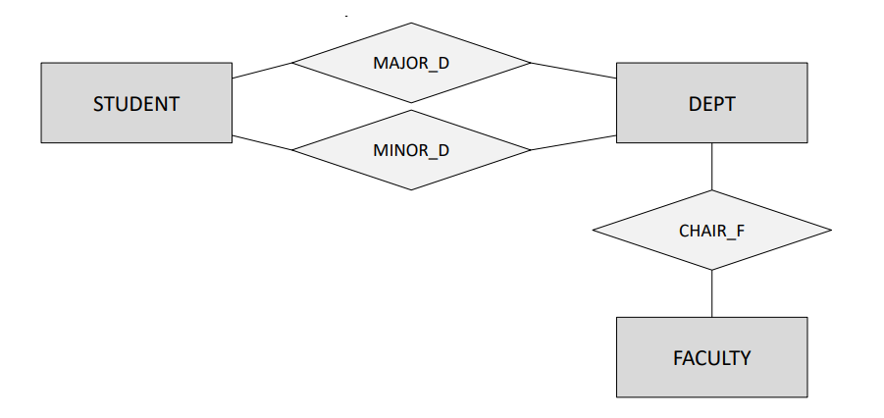
Relationships
Associates one or more sets of entities
One = recursive (role is important)
Example
Students may have any number of departments in which they minor.

Slide 21
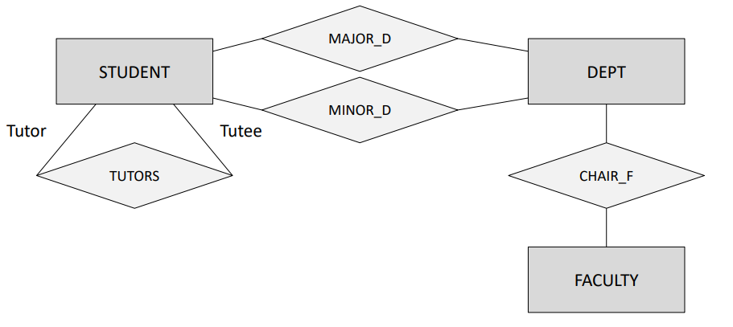
Relationships
Associates one or more sets of entities
One = recursive (role is important)
Example
Students can tutor other student(s)

Slide 22
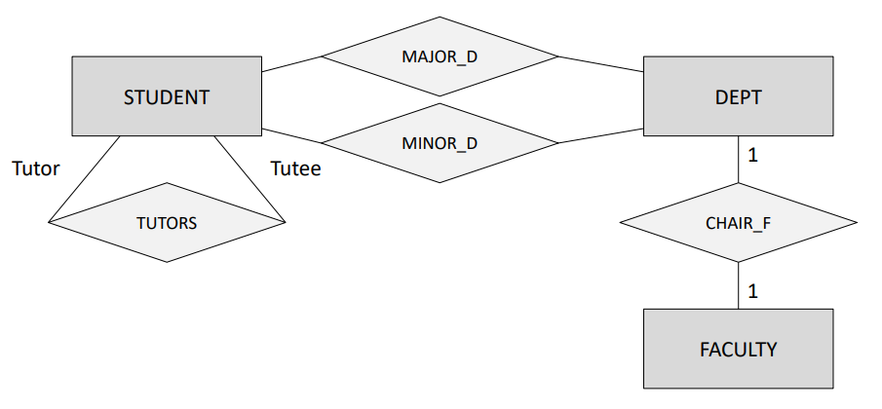
Cardinality Ratios
Constrains the number of entities that can participate in each role of the relationship
Example
All departments have a faculty member who serves as the chair. A faculty member can only chair one department.

Slide 23
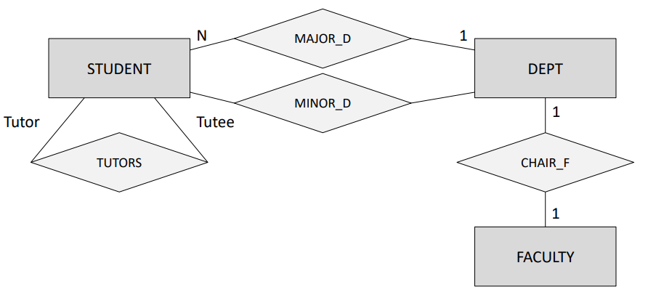
Cardinality Ratios
Constrains the number of entities that can participate in each role of the relationship
Example
All students must have a department 1 in which they major.

Slide 24
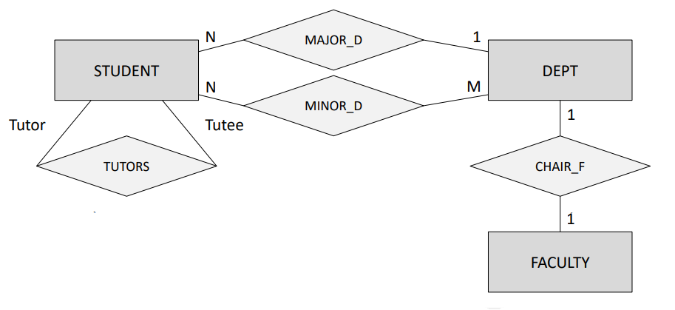
Cardinality Ratios
Constrains the number of entities that can participate in each role of the relationship
Example
Students may have any number of 1 departments in which they minor

Slide 25
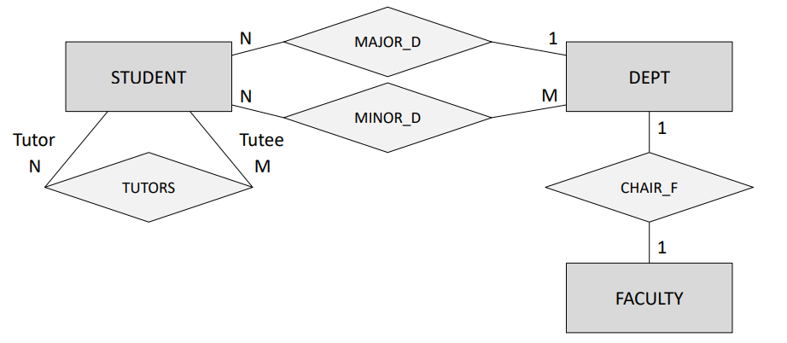
Cardinality Ratios
Constrains the number of entities that can participate in each role of the relationship
Example
Students can tutor other student(s).

Slide 26
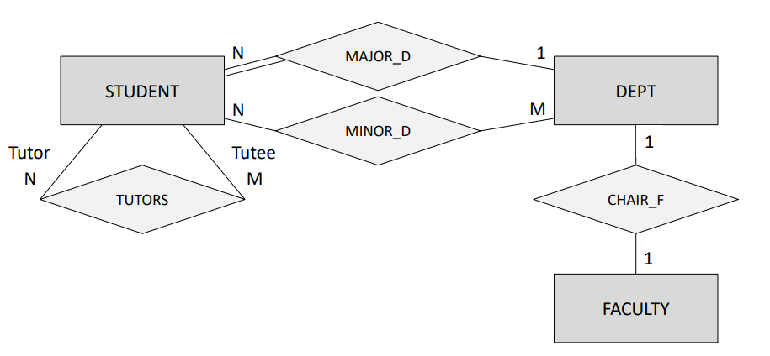
Participation Constraints
Total Participation
Each entity is involved in the relationship. Total participation is represented by double lines.
Example
All students must have a department in which they major.
Partial participation
Not all entities are involved in the relationship. Partial participation is represented by single lines.
Example
A faculty member can only chair one department.

Slide 27
Attributes of Relationships
In ER model, relationships can also have attributes associated to them.
Generally it is not recommended to give attributes to the relationships if not required because while converting the ER model into Relational model, things may get complex and we may require to create a separate table for representing the relationship.

Slide 28
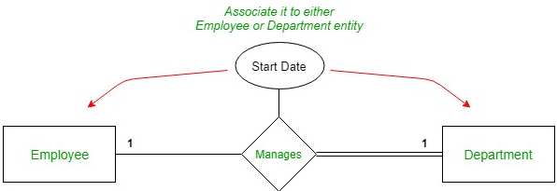
One to one relationship
In an organization, an employee manages a department, and each department is managed by some employee.
Now, if we want to store the Start_Date from which the employee started managing the department then we may think that we can give the Start_Date attribute to the relationship manages.
But, in this case we may avoid it by associating the Start_Date attribute to either Employee or Department entity.

Slide 29
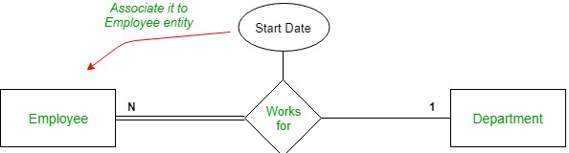
One to many relationship
In an organization, many employees can work for a department but each employee can work for only a single department.
So, there is a one to many relationship between the entities.
Now if we want to store the Start_Date when employee started working for the department, then instead of assigning it to the relationship we should assign it to the Employee entity.

Slide 30
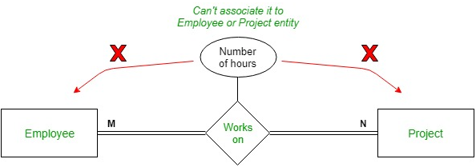
Many to many relationship
In an organization, an employee can work on many projects simultaneously and each project can have many employees working on it.
So here assigning the Number_of_Working_hours to the employee will not work as the question will be that it will store which project’s working hours because a single employee can work on multiple projects.
Similar the case with the project entity. Hence, we are forced to assign the Number_of_Working_hours attribute to the relationship.

Slide 31
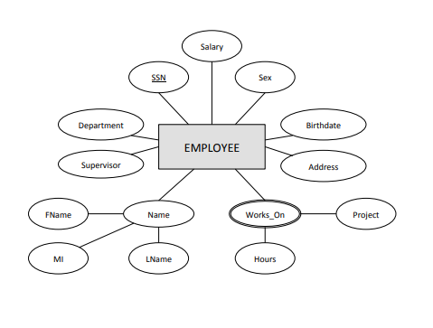
Exercise
We store each employee’s name (first, last, MI), Social Security number (SSN), street address, salary, sex (gender), and birth date. An employee is assigned to one department, but may work on several projects, which are not necessarily controlled by the same department. We keep track of the current number of hours per week that an employee works on each project.

Slide 32
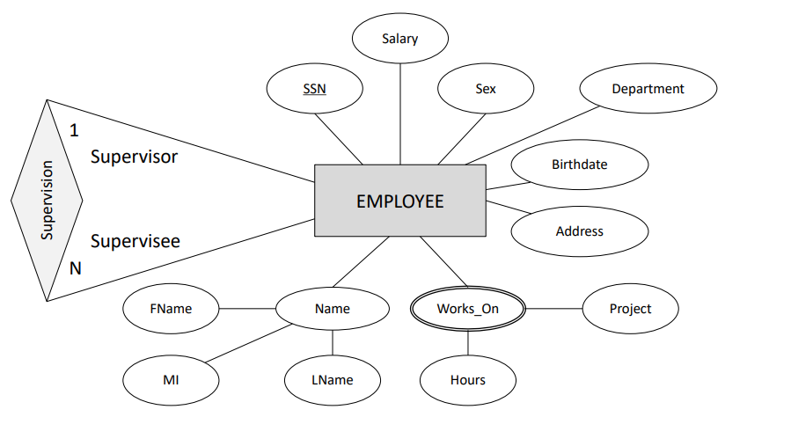
Example
We store each employee’s name (first, last, MI), Social Security number (SSN), street address, salary, sex (gender), and birth date. An employee is assigned to one department, but may work on several projects, which are not necessarily controlled by the same department. We keep track of the current number of hours per week that an employee works on each project. We also keep track of the direct supervisor of each employee (who is another employee).

Slide 33
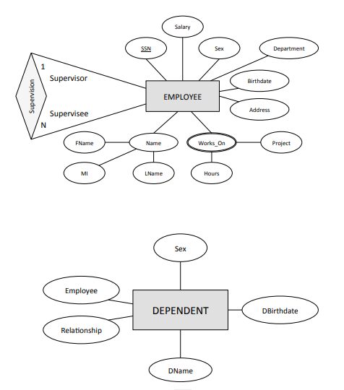
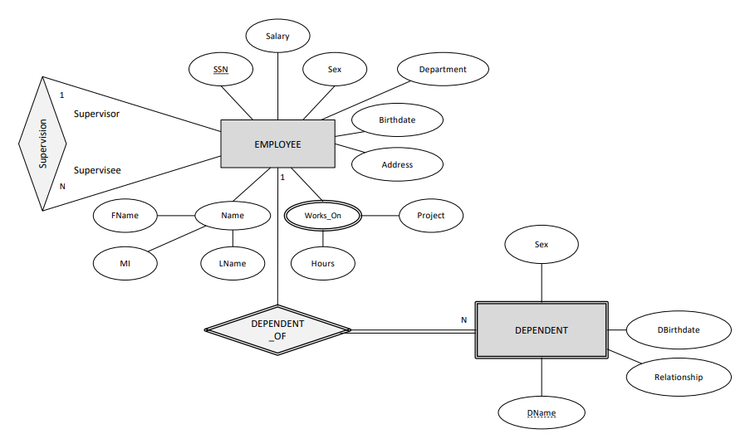
Example
We want to keep track of the dependents of each employee for insurance purposes. We keep each dependent’s first name, sex, birth date, and relationship to the employee

Slide 34
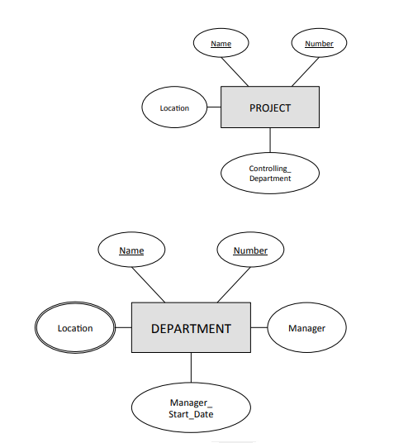
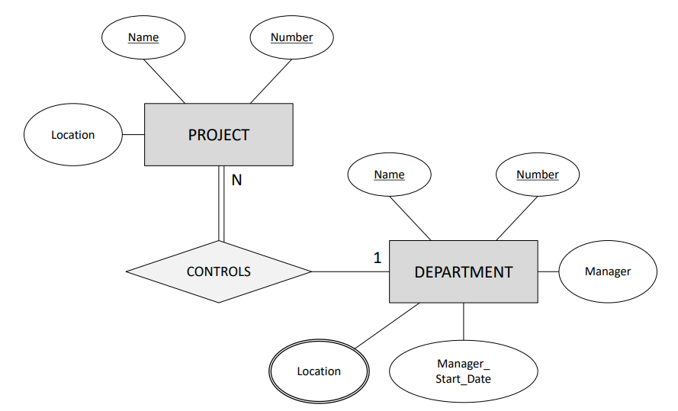
Example
A department controls a number of projects, each of which has a unique name, a unique number, and a single location.

Slide 35
Reference
Database Management Systems 3ed, R. Ramakrishnan and J. Gehrke
Entity/Relationship Modelling, Database Systems Lecture 4, Natasha Alechina
Entity-Relationship (ER) Diagrams, Lecture 7, CS3200 – Database Design, Spring 2018, Lecture 7

